Slide 1

APPLE

Slide 2

How does Apple earn revenue?
The majority of the revenue is earned through the products developed and sold by Apple. Out of these, the major share is coming from the sales of iPhones. The revenue is also generated through the sale of paid apps in iOS store, Mac store etc. Another way of earning revenue is through Apple search ads. Developers can pay Apple to have their product displayed first in the search list of the stores.

Slide 3
Customer Segments
This denotes the people for whom Apple is useful.
The large market
Availability of products in various platforms.
Various enterprises
Professional and educational users

Slide 4
Value Propositions
What all problems can Apple solve and what all do they have to offer.
To transform personal technology
The brand being the most valuable in the world
Unique value proposition when compared to other brands
Experiencing itself is the products
Unique products which stand out in the crowd
Hardware and software are excellent qualities
Things are kept simple
Products are user-friendly
Products are user-friendly
Excellent customer service as well as in-store experiences
Offers complete privacy to user data
Becoming the largest retailer of music in the world
The virtual services offered are excellent
Near-field communications possible
Data transfer, as well as payments to apps, are secure
Plans to produce electric car with automatic driving by 2020

Slide 5
Revenue Stream
What are the main income sources? Where do all the users have to pay?
Sale of products
Online and Media sales
Online subscriptions and services
Apple for Business
Apple search ads

Slide 6
Cost Structures
What are the types and relative proportions of fixed and variable costs that Apple incurs?
Advertising and designs
Research and development
Manufacturing and outsourcing costs
Stores and centers
Employees and operations

Slide 7
Products launched by Apple
Mac
iPhone
iPod
iPad
Apple Watch
Apple Music Store
Apple TV
Apple Music Store
Apple Pay
Shazam
Siri
Emagic
Beats Electronics
NeXT Inc
PrimeSense

Slide 8
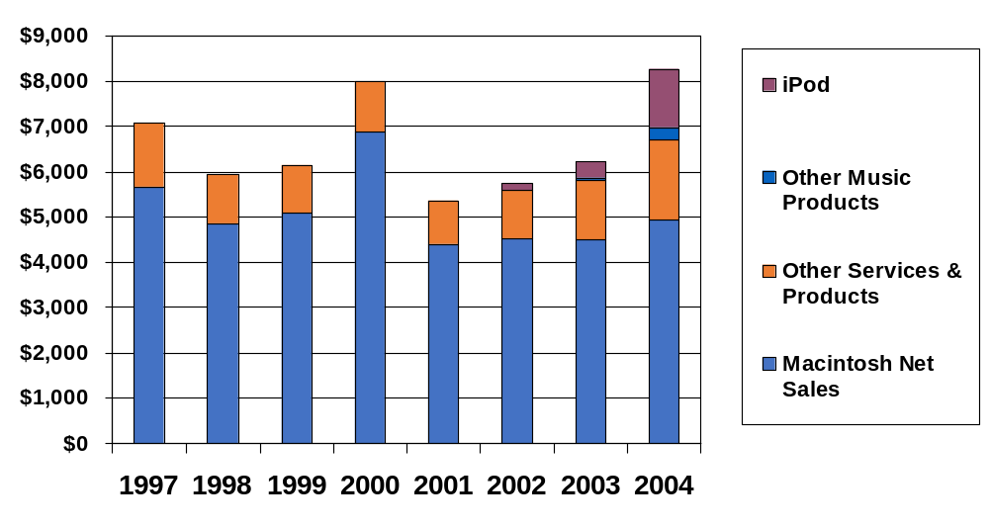
Apple Revenues
Source: Apple, Inc.
Notes:
Changing Product Mix; Changing Mix of Countries

Slide 9
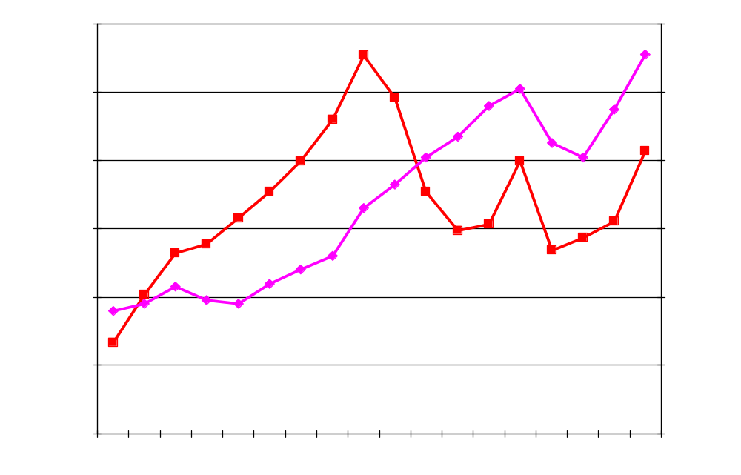
Apple vs. Computer & Peripherals
GDP
Consumer Products
Durable Goods
Computers &
Peripherals
Source: Dept. of Commerce & Apple, Inc.

